Slide 1
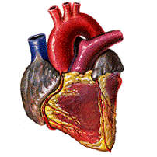
Combination Of Different Heart Signals for the Diagnosis of Heart Disease
Presented by:
Abdallah Magdy Fouad Habib
Osama Ahmed Mosleh
Hossam Hassan Mohamed Mohamed
AbdulRahman Hassan Abdulaal Rashwan
Fares Reda Ebrahim
Ahmed Atef Ahmed
Alaa Atia El-sayed Atiaa
AbdElRahman Hisham Mohamed
Supervised by :
Dr. Mahmoud Bassiouni
T.A. Amany Hamdy
Notes:
Abdallah

Slide 2

Introduction
Motivations
Problem Definition
Objectives
Methodology
Data Acquisition
Pre-processing
Segmentation
Classification
Experiments and Result
Tools and Technologies
Gantt chart
Android App UI
Demo
Notes:
Abdallah

Slide 3
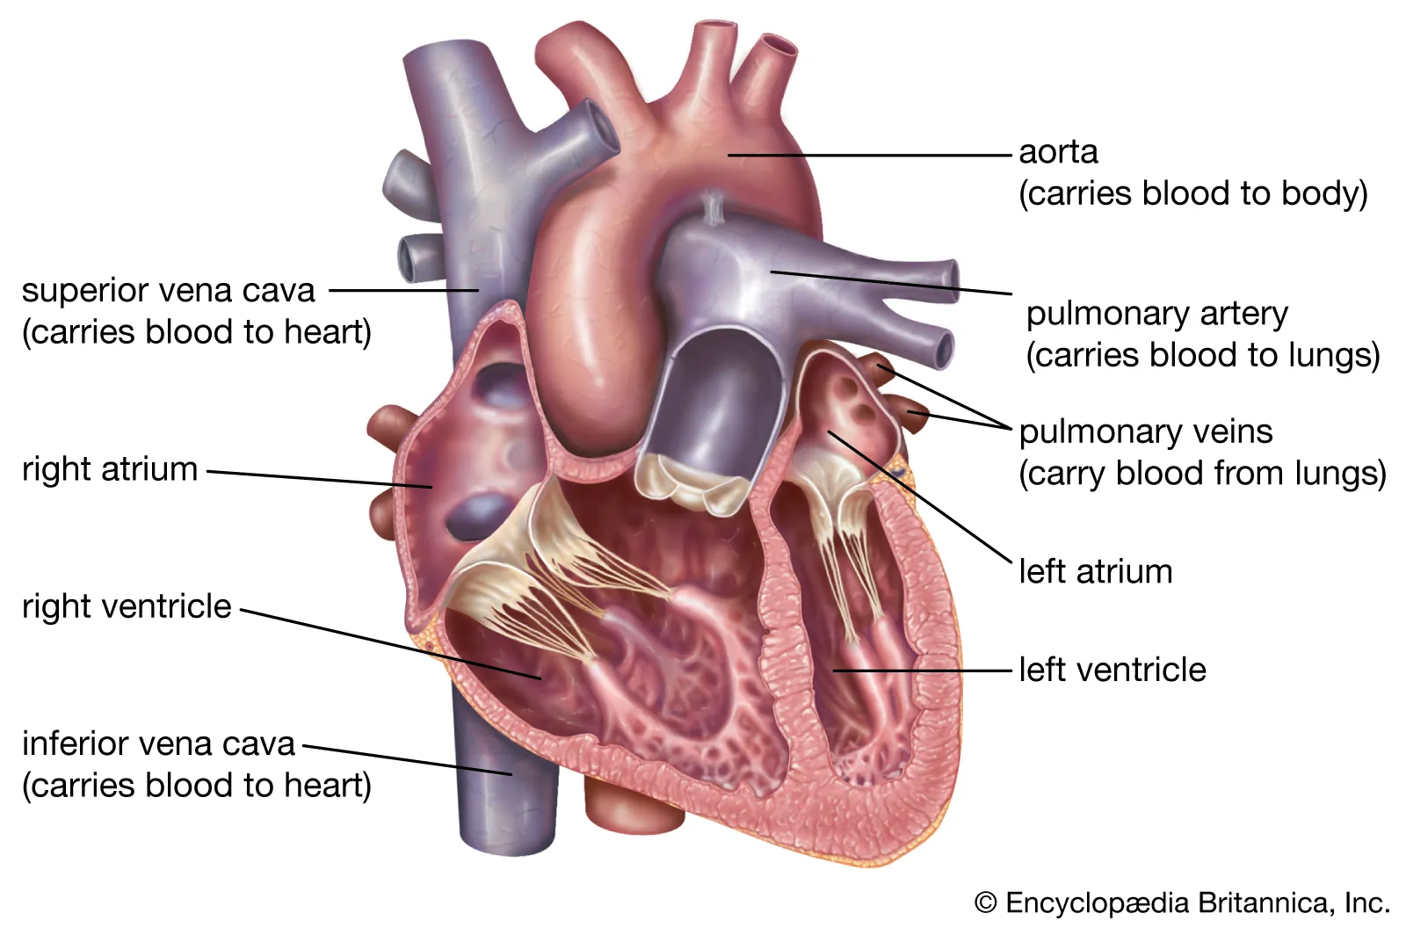
Introduction
The human heart is an organ that serves as a pump to circulate blood through the body's network of blood vessels.
Many factors can increase the risk of heart disease, such as age, family, and medical history).
Many other risk factors can contribute to heart diseases such as obesity, high cholesterol, and smoking, etc.
Heart disease s are diagnosed via heart signals such as ECG, PCG, and ABP.
Notes:
Abdallah

Slide 4
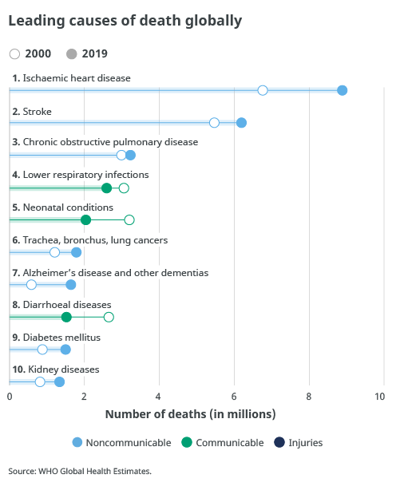
Motiviation
Before COVID-19, heart disease was the leading cause of death worldwide. Ischemic heart disease, in particular, was highlighted as the world's biggest killer, responsible for 16% of total deaths in 2019.
A significant proportion of heart attacks occur in individuals who do not exhibit the classic risk factors or prior symptoms typically associated with cardiovascular disease, making heart disease a hardly detectable condition.
Heart disease has an enormous financial impact on individuals or nations as it has a high-cost implication compared to other diseases.
Notes:
Abdallah
https://www.who.int/news-room/fact-sheets/detail/the-top-10-causes-of-death

Slide 5
Problem Definition
Heart function may be monitored by electrical activity (electrocardiogram, ECG) , echocardiography, or heart sound auscultation (phonocardiogram, PCG). Diagnosis using one signal only may lead to inaccurate diagnosis
The difficulties in the classification of PCG heart sound records into normal and abnormal are due to noise and distortion of recorded wave signals.
The technological limitation and Knowledge shortage in building an automated tool to classify PCG records.
In the emergency cases it is difficult to measure different activities of the heart especially for the heart patients.
Notes:
Abdallah

Slide 6
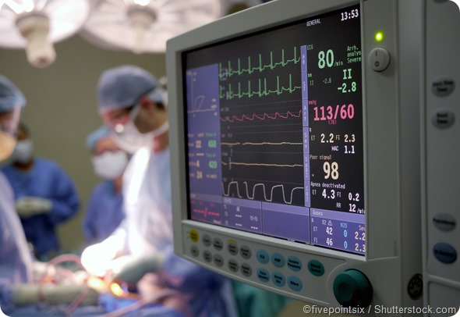
Objectives
Build three main systems for heart diagnosis. The First two systems are for expert medical professionals, and the third is for patients and general public use.
The first two systems are developed using MATLAB based on five stages: data acquisition, pre-processing, segmentation, Feature extraction, and classification.
The First System is used to diagnose patients as either normal or abnormal based on a combination of ECG and PCG signals.
The second system aims at classifying patient into one of five categories based on their combined ECG and ABP signals.
The third System is a heart health care app that performs features like heart rate, blood pressure calculation, Respiration rate, and Oxygen saturation, and is developed using Android.
Notes:
Abdallah

Slide 7
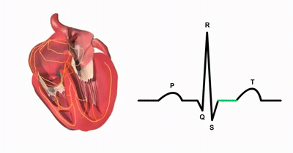

Electrocardiogram (ECG)
Electrocardiogram (ECG) signals are considered one of the most important attributes for continuously monitoring human health.
The ECG signals consist of five main peaks, which are the P, Q, R, S, and T.
The ECG technology depends on the electrical impulses of the heart.
Notes:
Abdelrahman 1st

Slide 8
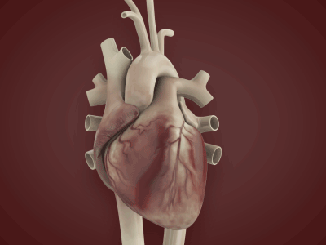
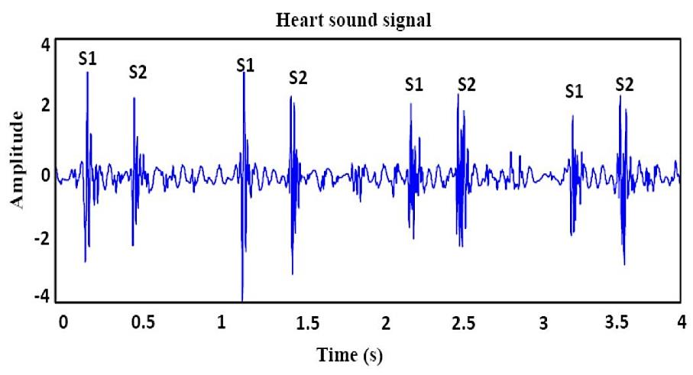
Phonocardiogram (PCG) Heart Sounds
A phonocardiogram (or PCG) is a plot of high-fidelity recording of the sounds and murmurs made by the heart with the help of the machine called the phonocardiograph; thus, phonocardiography is the recording of all the sounds made by the heart during a cardiac cycle.
Two sounds are normally produced as blood flows through the heart valves during each cardiac cycle.
The first heart sound S1, is a low, slightly prolonged “lub”, The second sound S2 is a shorter, high-pitched “dup”.
Notes:
Abdelrahman 1st

Slide 9
Methodology First System – ECG/PCG
Data Acquisition
Data Pre-processing
Segmentation
Feature Extraction
Classification
Normal
Abnormal
Notes:
Osama

Slide 10
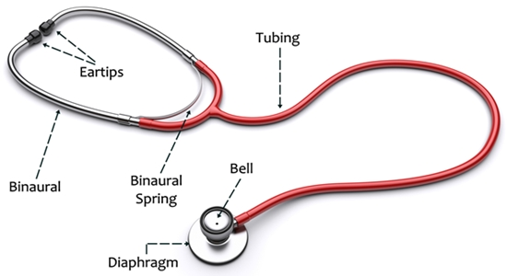
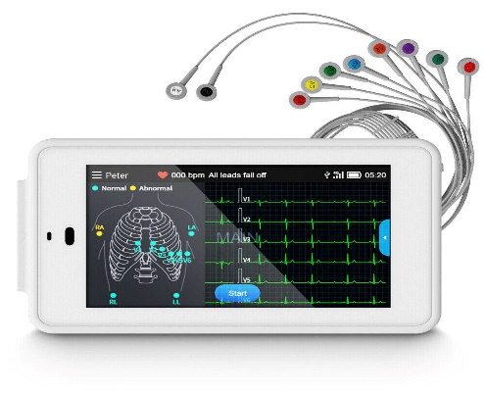
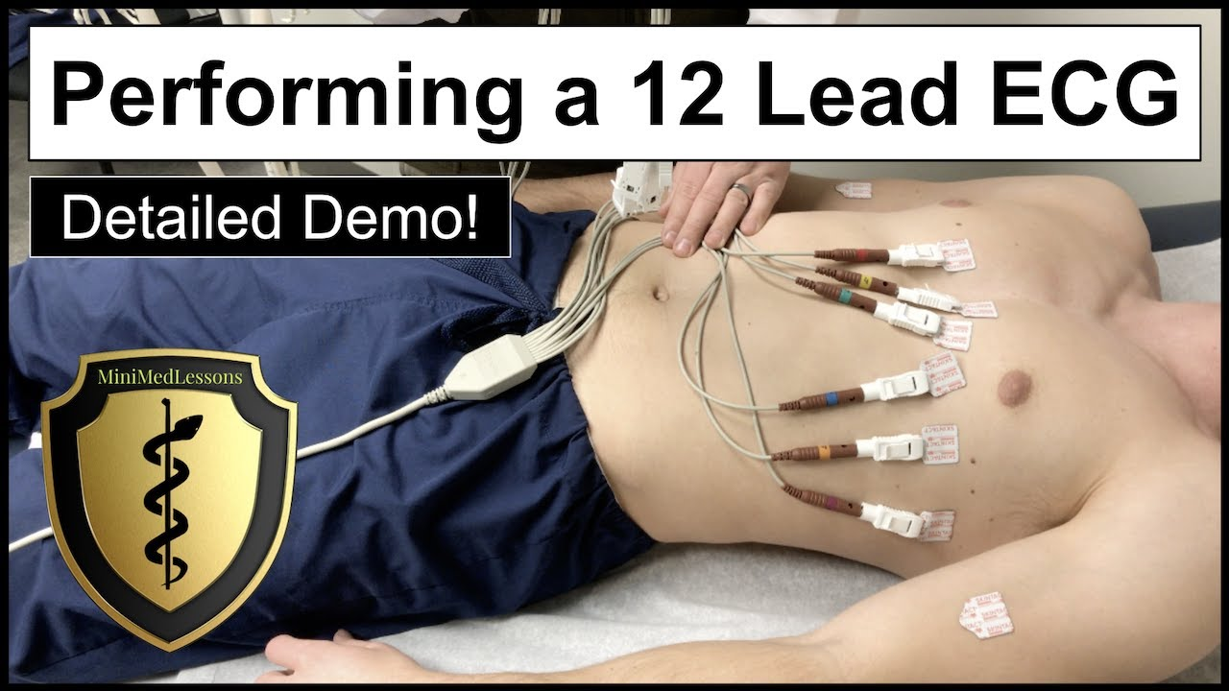
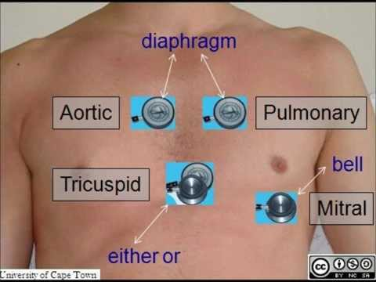
Data Acquisition (ECG and PCG)
There are two ways to obtain ECG and PCG signals:
The first way is using an electronic stethoscope; the electronic stethoscope is placed on the chest of the participant, seated in a relaxed position, and the PCG is obtained, while ECG can be captured using Electrodes (small, plastic patches that stick to the skin) placed at specific points on the chest and abdomen. The electrodes are connected to an ECG machine by wires. Then, the heart's electrical activity can be measured, recorded, and printed. No electricity is sent into the body.
Notes:
Osama

Slide 11
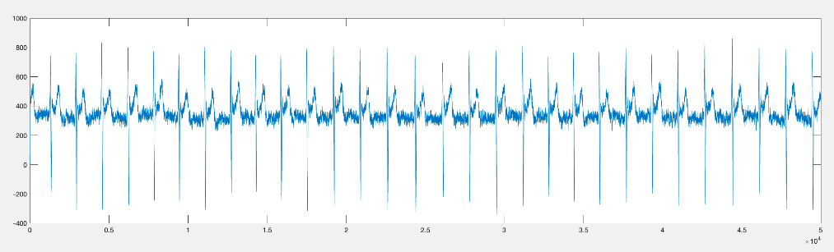
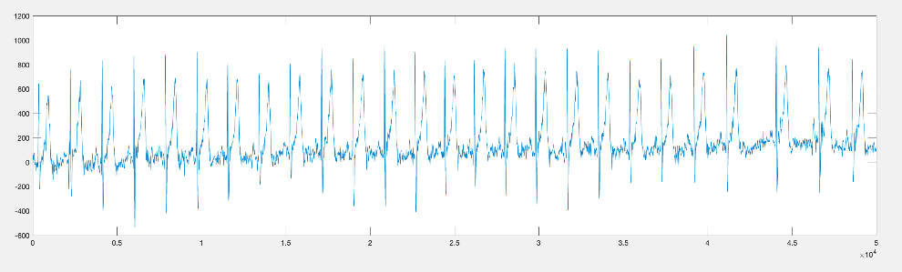
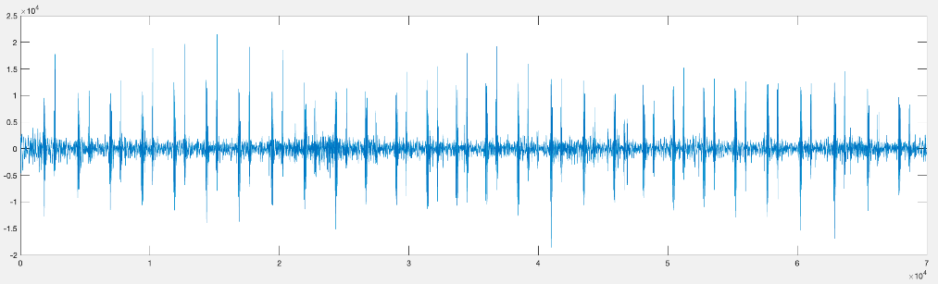
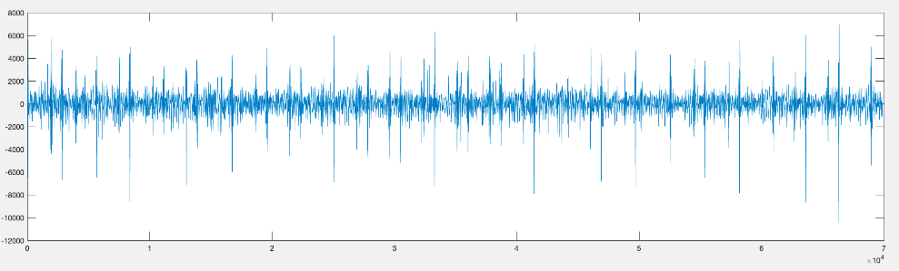
Data Acquisition
The second way is based on gathering the ECG and PCG signals online.
It is not easy to find a dataset available online that holds both ECG and PCG for diagnosing heart diseases. The only one available now is the Physionet/Computing in Cardiology Challenge 2016 dataset.
The Data are divided into 113 normal and 290 abnormal ECG and PCG Signals.
Normal ECG
Abnormal ECG
Normal PCG
Abnormal PCG
Notes:
Osama

Slide 12
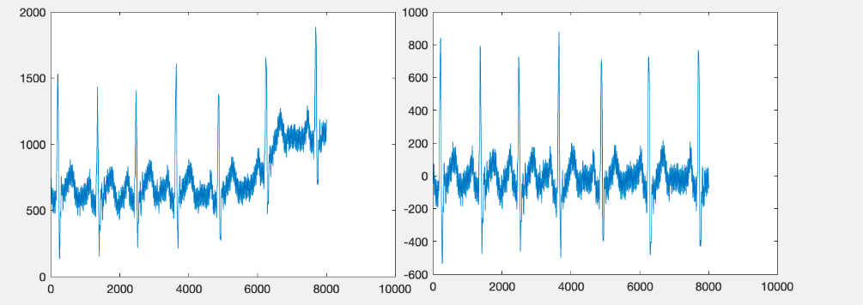
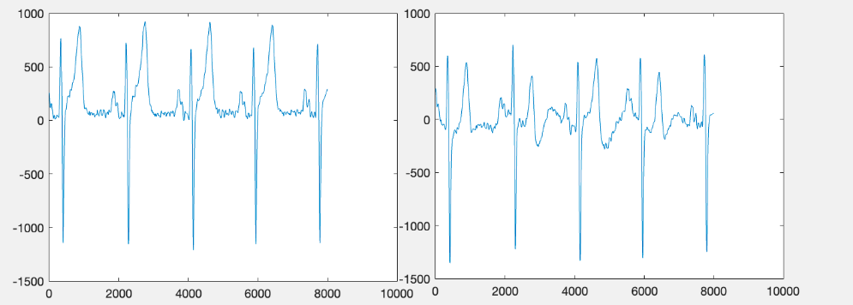
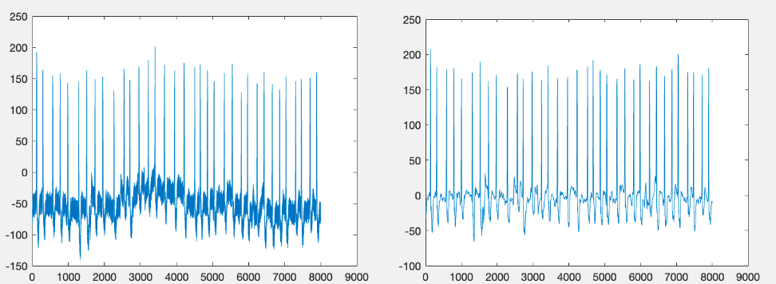
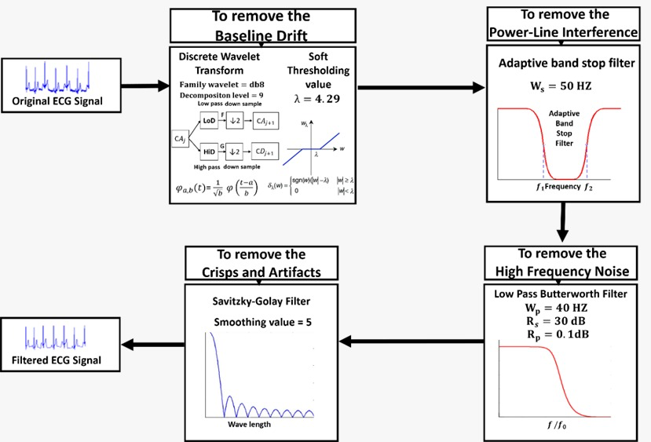

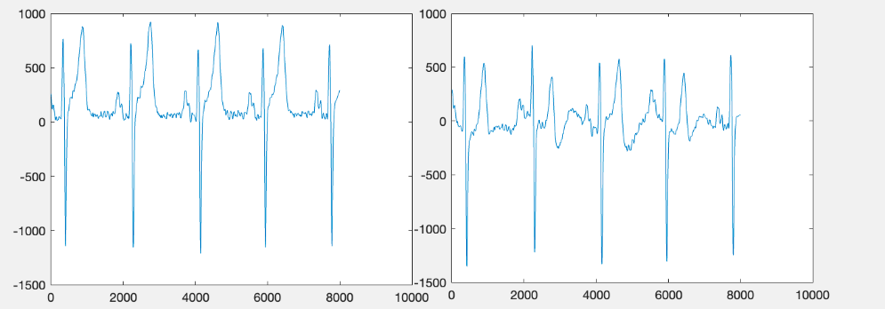
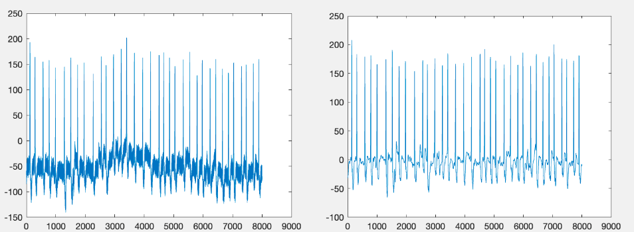
Pre-processing of ECG Signals
Several types of noise exist in the ECG records and can result from various sources.
Three prominent everyday noises exist in the ECG signals: baseline drift, powerline interference, and high-frequency noise; in some cases, a combination of them is also available.
Baseline Drift
Powerline Interference
High Frequency Noise
Notes:
Fares

Slide 13
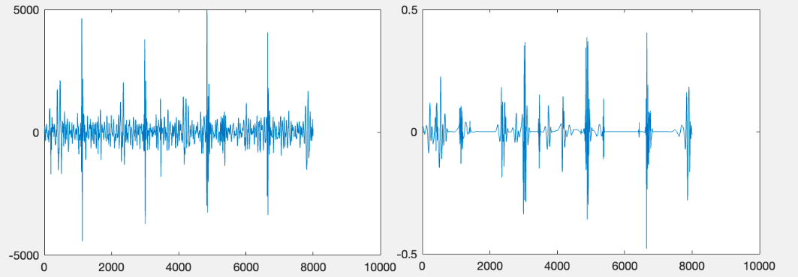
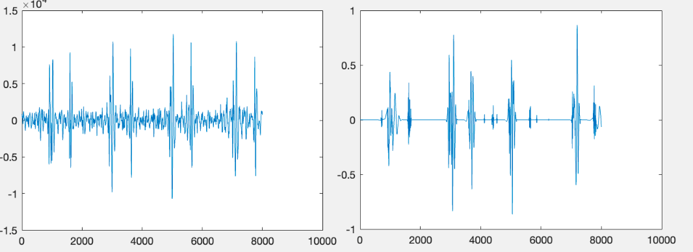
Pre-processing of PCG Signals
Prominent common noise that appears in the PCG signals is the High-frequency Noise.
This kind of noise is removed by multiresolution decomposition reconstruction (MRD-MRR).
Notes:
Fares

Slide 14
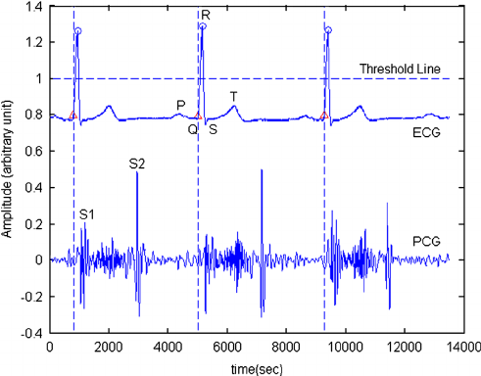
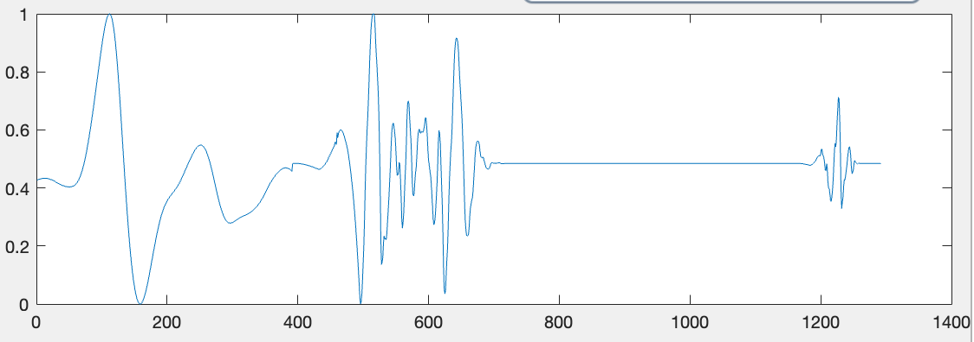
Segmentation of ECG and PCG
ECG and PCG are segmented heartbeat by heartbeat, and PCG is selected based on ECG heartbeats.
The length of the ECG is 391 samples, and the ECG fragment is chosen on the R peak, subtracted by 200 samples, and 140 samples added.
The length of the PCG is 900 samples, and the PCG fragment is chosen on the R peak, subtracted by 200 samples, and 700 samples added.
Notes:
Ahmed Atef

Slide 15
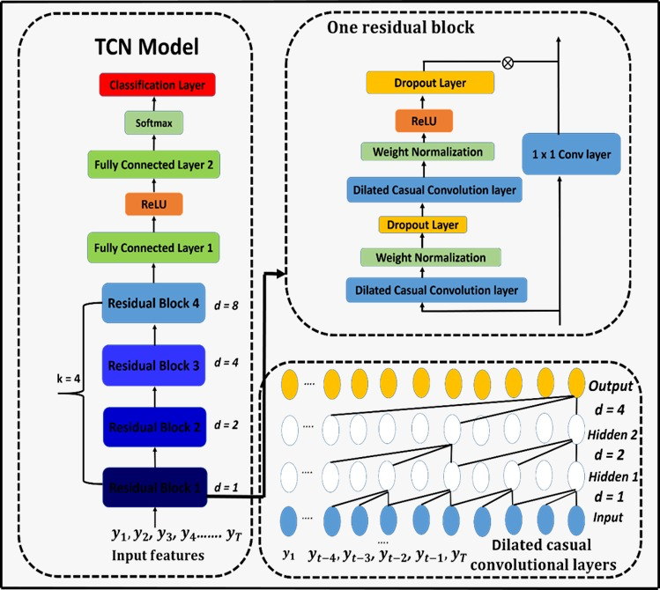
Feature Extraction using TCN
Temporary convolutional neural network (TCN) aims to compute the low-level features that represent the spatial-temporal information using CNN Layers.
The main components and layers of TCN are a series of dilated causal convolutions, weight normalization, dropout layers, nonlinear activation functions, and residual blocks.
Notes:
Hossam

Slide 16
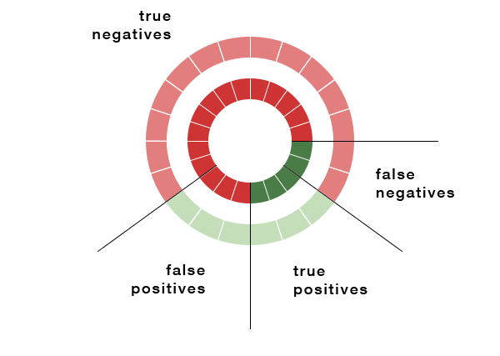
Classification
Classification is a process in which the extracted features are compared against the stored template to generate a score.
We will discuss three different classifiers used, starting with the Naïve Bayes, K-nearest neighbor (KNN), Support Vector Machine (SVM)
Notes:
Hosaam

Slide 17
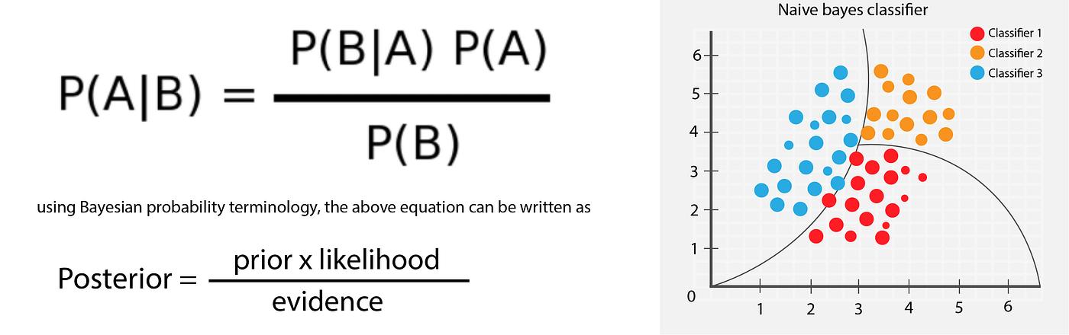
Classification (Naïve Bayes)
In machine learning, naïve Bayes classifiers are a family of simple “Probabilistic classifiers” based on applying Bayes’ theorem with strong (naïve) independence assumptions between the features.
Notes:
Hosaam

Slide 18
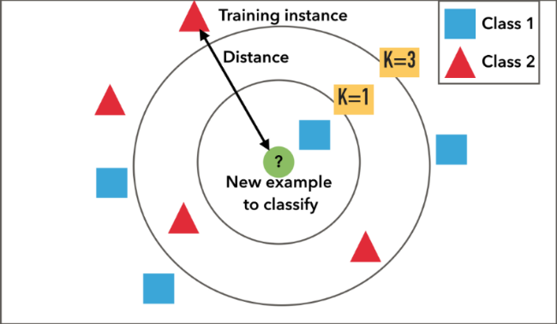
Classification (KNN)
K-Nearest Neighbor algorithm (KNN) is a classification method based on closest training samples. It compares a new problem instance with instances seen in the training.
It constructs hypothesis directly from the training instances themselves
Notes:
Abdelrahman 2nd

Slide 19
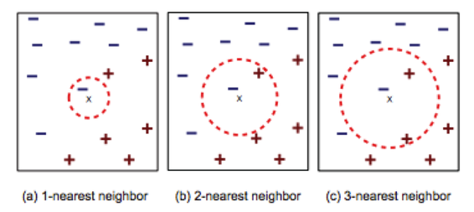
Classification (KNN)
K-Nearest Neighbor algorithm (KNN) has different distance measurements to apply. Those distance as (Cosine, Euclidean ,Hamming, City block, Correlation ). We used the Euclidean distance with number of neighbors k =1.
Notes:
Abdelrahman 2nd

Slide 20
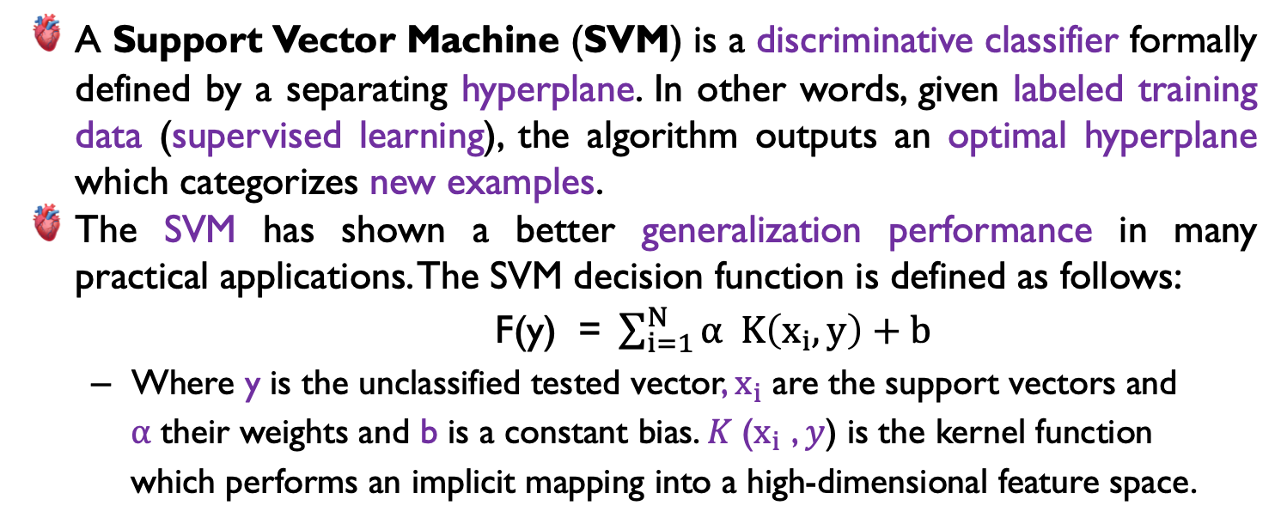
Classification(SVM)
A Support Vector Machine (SVM) is a discriminative classifier formally defined by a separating hyperplane. In other words, given labeled training data (supervised learning), the algorithm outputs an optimal hyperplane which categorizes new examples.
The SVM has shown a better generalization performance in many practical applications. The SVM decision function is defined as follows:
F(y) =$\sum_{i=1}^{N}{α K\left(x_{i},y\right)+b}$
Where y is the unclassified tested vector, $x_{i}$ are the support vectors and
$α$ their weights and b is a constant bias. 𝐾 ($x_{i}$ , 𝑦) is the kernel function
which performs an implicit mapping into a high-dimensional feature space.
Notes:
Alaa

Slide 21
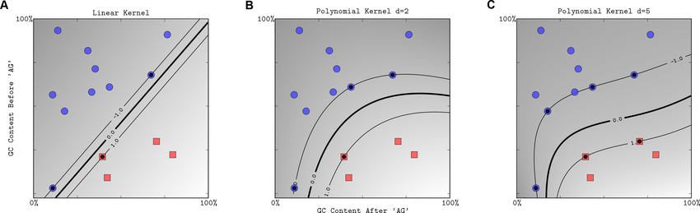
Classification (SVM)
SVM works using different kernel functions (Linear, quadratic, polynomial). The kernel function used in our classification is polynomial kernel function with polynomial order P = 3.
Notes:
Alaa

Slide 22
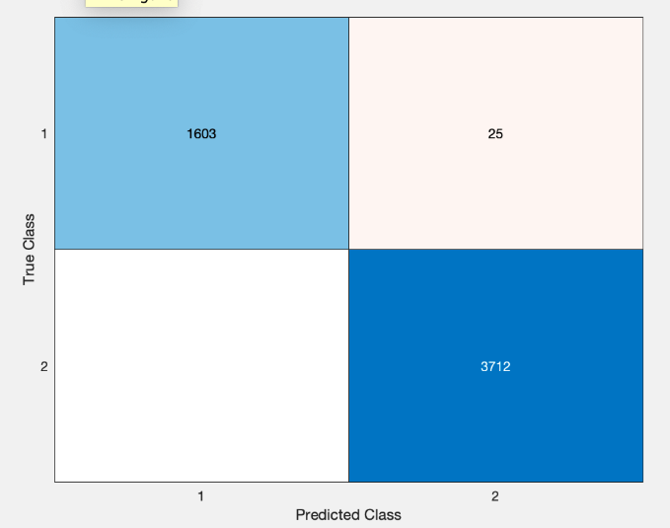
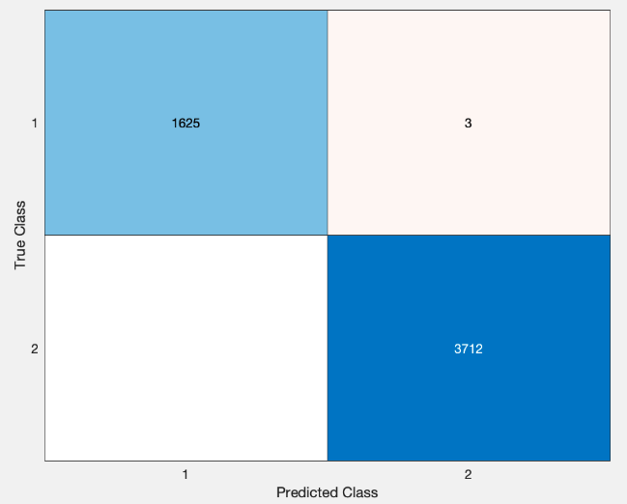
Experiments and Result
The proposed system trained on 60% (8011) and 40% (5340) for test. The classification results of the system is defined in the following table.
Performance | NB | KNN | SVM
Accuracy | 99.5318 | 99.9438 | 99.9438
NB Confusion Matrix
KNN Confusion Matrix
SVM Confusion Matrix
Notes:
Abdallah

Slide 23




Tools and Technologies
Mobile App Development
UI Development
Data Processing & Machine Learning
Documentation &
collaboration
Notes:
malAbdallah

Slide 24
Gant Chart
Project Schedule | Combination of Heart Signals for the diagnosis of Heart diseases
Tasks | OCT |  |  |  | NOV |  |  |  | DEC |  |  |  | JAN |  |  |  | FEB |  |  |  | MAR |  |  |  | April |  |  |  | MAY |  |  |  | JUN
 | 1 | 2 | 3 | 4 | 1 | 2 | 3 | 4 | 1 | 2 | 3 | 4 | 1 | 2 | 3 | 4 | 1 | 2 | 3 | 4 | 1 | 2 | 3 | 4 | 1 | 2 | 3 | 4 | 1 | 2 | 3 | 4 | 1 | 2 | 3 | 4
Learning DL and Android
Reading on Hearts Medical signals
Building First System using ECG and PCG
Building Mobile Application
Presentation Preparation
Building Second System using ECG and ABP
Continue Finishing Mobile Application
Integrating All Systems in One APP
Testing & Documentation
Testing & Documentation
To be Added
Notes:
Ahmed Atef

Slide 25
Thank you

